Slide 1
Defensive Security Project by:
Maryna Yaroshenko
Notes:
Hackers, Defenders, and Cyber Warriors Welcome!
First off, a big shoutout to my amazing teammates: Maryna and Josh. We’ve been through thick and thin, deciphering logs and setting alerts, and now we’re here to share our journey with you.
Today, you’ll step into the shoes of SOC analysts at Virtual Space Industries (VSI), a company that’s at the forefront of designing virtual-reality programs for businesses.
Rumor has it that a rival, JobeCorp, might be planning cyberattacks to disrupt VSI’s business. As SOC analysts, we will be using Splunk to monitor and safeguard your systems from these potential threats. Think of this session as a behind-the-scenes tour of the internet's secret life. We’ll uncover the stories hidden in our server logs, chase down pesky digital potholes, and maybe even spot some overzealous party crashers trying to sneak into our system.
So, get ready for a journey that’s part cyber-sleuthing, part tech-talk, and entirely enlightening.

Slide 2
Table - Contents
This document contains the following resources:
Monitoring Environment
Attack Analysis
Project Summary & Future Mitigations
Notes:
Alright, let’s take a tour of today’s adventure.
First up, we’ll dive into our monitoring environment. We’ll walk you through how we set up and configured our Splunk environment, and how we harnessed it to keep an eagle eye on our logs. Think of it as our behind-the-scenes look at how we keep the digital world in check.
Next, we’ll delve into attack analysis. This is where we get into the trenches, analyzing the data and understanding what’s been happening under the hood. We’ll break down the incidents, examine the patterns, and highlight the key findings.
Finally, we’ll wrap up with a summary of our project and our future mitigation plans. Here, we’ll review the key takeaways from our work and discuss the strategies we’ll use to stay ahead of future threats. Consider this the grand finale, where we tie everything together and look forward to what’s next.
Let’s go!

Slide 3

Monitoring Environment
‹#›
Notes:
Alright, Welcome to the overview of our monitoring environment. Today, we'll walk through how we leverage advanced tools to maintain and secure our infrastructure effectively.
Our monitoring environment is designed to ensure real-time visibility and management of our infrastructure, which includes servers, virtual machines, cloud services, and web applications. The key components of our setup include:
Splunk which is our core platform we use for data collection, analysis, and visualization.
And Splunk Add-Ons: To enhance Splunk’s capabilities by integrating additional data sources and providing specialized analysis.
Some Key Components we implemented are:
Data Collection and Analysis gathering logs and metrics from various sources like servers, network devices, and applications. Processes and analyzes this data to provide actionable insights.
We used Dashboards to Visualizes data trends and patterns, aiding quick decision-making with custom dashboards.
We included a Specialized Add-On that Includes tools like the Whois XML Website Categorization API, which helps identify potentially malicious domains by categorizing websites in real-time.
We utilized Real-Time Monitoring to Continuously tracks server health, application performance, and network traffic. Regularly examines logs for unusual patterns or security incidents.
Alerting helps us to Configure notifications for critical issues such as high CPU usage, failed logins, or suspicious activities.
and Reporting and Troubleshooting to generate reports on key metrics, incidents, and trends. Provides detailed incident reports with root cause analysis and troubleshooting insights to address performance issues and system errors.
In conclusion! Our monitoring environment combines robust data collection, real-time analysis, and proactive alerting to maintain and enhance the performance and security of our infrastructure. By leveraging Splunk and its add-ons, we ensure a comprehensive and effective monitoring strategy.

Slide 4
Scenario
Monitoring and Security for VSI
The objective of this project was to implement a comprehensive monitoring solution for Virtual Space Industries (VSI) using Splunk. This involved setting up the Splunk Docker container and analyzing logs from Windows (`windows_server_logs.csv`) and Apache (`apache_logs.txt`). The analysis focused on key fields such as `signature_id`, `signature`, `user`, `status`, and `severity` for Windows logs, and `method`, `referer_domain`, `status`, `clientip`, and `useragent` for Apache logs.
Several reports were created to provide insights into the data, including signature IDs, severity levels, and activity success versus failure for Windows logs, as well as HTTP methods, top referrers, and response codes for Apache logs. Alerts were configured to notify the SOC team of significant issues, including high rates of failed logins, successful logins, and account deletions for Windows, and unexpected international traffic and high volumes of POST requests for Apache.
Dashboards were designed to visualize trends and metrics, with charts for Windows logs showing signature trends, user activity, and counts, and Apache logs including HTTP methods, traffic distribution, URI counts, and user agents. Additionally, an extra Splunk add-on was selected and installed to enhance monitoring capabilities.
This solution provides VSI with a robust system for detecting and responding to potential security threats, ensuring both security and operational oversight.
Notes:
We kicked off by setting up the Splunk Docker container— Our logs came from two crucial battlegrounds: Windows servers and Apache web servers.
For Windows logs, we delved into fields like signature_id, signature, user, status, and severity—basically, we were deciphering the secret codes of our server’s behavior.
For Apache logs, we examined methods, referrer domains, status, client IPs, and user agents, analyzing web traffic patterns like data detectives on the hunt for clues.
We produced some impressive reports:
- For Windows, we tackled signature IDs, severity levels, and success vs. failure rates—like scoring our server’s report card.
- For Apache, we identified the HTTP methods, top referrer domains, and response codes, giving us a clear snapshot of web traffic and server health.
To keep us on our toes, we set up alerts for potential issues:
For Windows: We alerted for high failed logins, successful logins, and account deletions—basically, we’re on constant lookout for anything suspicious.
For Apache: We monitored for unexpected international traffic and high volumes of POST requests, ensuring no rogue activity sneaks past us.”
Our dashboards allowed us chart signature trends, user activity, and counts on Windows and For Apache, to visualize HTTP methods, traffic distribution, URI counts, and user agents. They’re like the command center screens from sci-fi movies, showing us the pulse of our data.
Finally, we installed an extra Splunk add-on, supercharging our monitoring capabilities. Think of it as adding a high-tech gadget to our already impressive toolkit.
In summary, this project has equipped VSI with a formidable monitoring solution, allowing us to detect and respond to security threats with agility and precision. It’s like having a vigilant sentinel overseeing both our security and operational performance.

Slide 5
Whois XML Website Categorization API for Splunk
‹#›
Notes:
Now, we dive into the Whois XML Website Categorization API for Splunk. This powerful tool seamlessly integrates with Splunk to enhance its capabilities by providing real-time domain categorization.
Imagine having a supercharged Splunk that can not only analyze your logs but also automatically flag domains as 'Malware,' 'Phishing,' or other potentially harmful categories. This API transforms raw data into actionable insights, helping you detect and respond to threats more efficiently.
With this integration, your security team can quickly identify suspicious activity, streamline their analysis, and improve overall security monitoring. It's like giving your Splunk an extra set of eyes to keep your network safe and sound.
Stay tuned as we explore how this integration works and the significant benefits it brings to our security operations!"

Slide 6
Whois XML Website Categorization API for Splunk
Whois XML Website Categorization API for Splunk provides real-time website categorization and threat intelligence. It enhances security by classifying web traffic based on categories like malicious, suspicious, or benign.
Key Features:
Real-Time Monitoring: Provides immediate categorization of referrer domains and websites, allowing for instant insights into their nature and potential risks.
Troubleshooting: Helps in identifying and categorizing domains associated with malware, phishing, or other security threats.
Alerting: Configurable alerts for detecting and responding to traffic from suspicious or malicious domains.
Scalability: Efficiently handles large volumes of domain data, making it suitable for extensive web environments.
Integration: Seamlessly works with other Splunk apps.
!
Seamlessly integrates with Splunk to provide real-time website categorization, enhancing threat detection and overall security monitoring.
Notes:
Key Features of this powerful tool are:
To begin with, this add-on features Real-Time Categorization which Automatically classifies domains into categories, such as business, entertainment, or technology.
Next is it utilizes Enhanced Security Monitoring which Helps in identifying potentially risky domains by categorizing them, which improves overall security insights.
Lastly is the implementation of Simplified Integration Works which workssmoothly existing Splunk setups, requiring minimal configuration.
By using this add-on, we can improve our ability to monitor and respond to security threats related to domain traffic, providing more actionable intelligence and enhancing our overall security posture

Slide 7
Whois XML Website Categorization API for Splunk
A security team notices a spike in outbound traffic to various domains, potentially indicating data exfiltration or access to malicious websites through:
Integration: The team integrates the Whois XML API with Splunk.
Monitoring: They monitor network traffic and categorize domains in real-time.
Categorization: The API categorizes domains, flagging potential exploits.
Analysis: The team identifies legitimate traffic and suspicious activity.
Alerting: Alerts are set for malicious categories, triggering investigations.
Mitigation: Compromised endpoints are isolated, and malicious domains blocked.
The team quickly identifies and mitigates threats with:
Proactive Detection: Early detection of malicious activity.
Efficient Analysis: Distinguishes between legitimate and suspicious traffic.
Enhanced Security: Quick response to threats, reducing data breach risks.
Improved Network Safety: Blocking malicious domains ensures safer internet usage.
Notes:
Imagine your security team identifies a sudden spike in outbound traffic to various domains. This could signal potential data exfiltration or access to malicious websites.
To address this, we integrate the Whois XML API with Splunk. We initiate real-time monitoring of network traffic and categorize domains using the API. The API flags domains based on their characteristics.
We then analyze the categorized data to distinguish between legitimate and suspicious activities. Alerts are configured for domains categorized as malicious, prompting immediate investigations.
Compromised endpoints are isolated, and access to malicious domains is blocked. This proactive approach enables us to quickly identify and mitigate threats, streamlining the analysis process and ensuring prompt responses to security incidents.
There are some great benefits to this tool including: Early Detection which Enables proactive identification of malicious activity, staying ahead of potential threats.
Efficient Analysis that Simplifies the differentiation between legitimate and suspicious traffic.
Enhanced Security which Facilitates rapid response to threats, minimizing the risk of data breaches.
And lastly, Improved Network Safety for Blocking malicious domains promotes safer internet usage for all users.

Slide 8
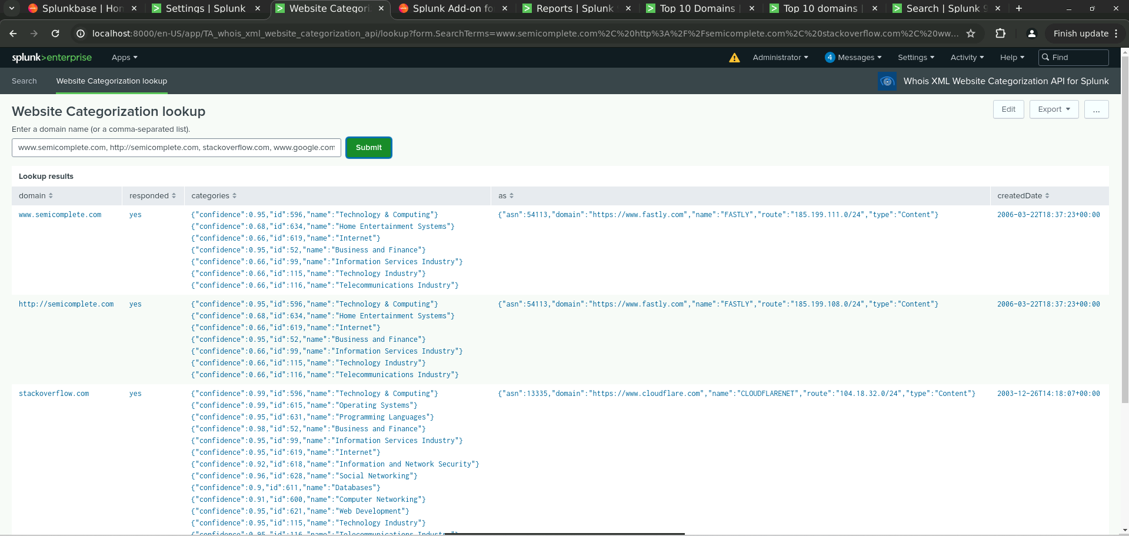
Whois XML Website Categorization API for Splunk
Notes:
By leveraging fields such as categories, domain, responded, AS, and createdate, organizations can effectively detect and respond to potential security threats, ensuring a more secure network environment.
The categories field Shows the type of website (e.g., malware, phishing), helping identify potential threats.
The domain field Identifies the specific website being analyzed.
The responded field Indicates when the categorization request was processed.
The AS (Autonomous System Number) field Provides information about the network or hosting provider behind the domain.
And finally the createdate field Reveals when the domain was created, which can help assess its legitimacy.
These fields collectively help in understanding the nature, source, and potential risk of websites accessing your network.

Slide 9
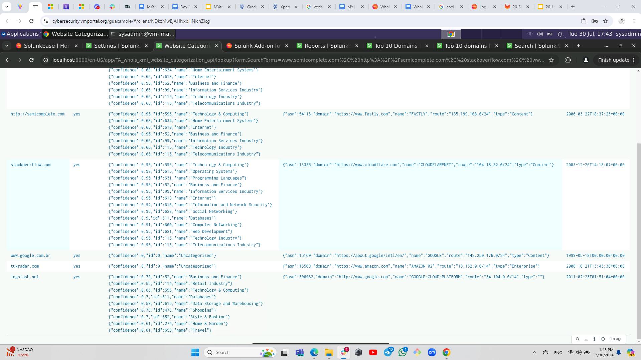
Whois XML Website Categorization API for Splunk
Notes:
By integrating the Whois XML Website Categorization API with Splunk, organizations can improve their ability to detect and respond to potential threats based on real-time domain categorization, enhancing overall network security and operational efficiency.

Slide 10
Logs - Analyzed
Windows Logs
Apache Logs
1
2
The ‘windows_server_logs.csv’ file contains security logs from a Windows server, which include critical information for monitoring and analyzing activities on the server. These logs help identify potential security incidents, track user actions, and understand the overall security posture of the server.
The purpose of these logs are to track user activity, detect security risks, and record forensic analysis.
The ‘apache_logs.txt’ file contains logs from an Apache server, which are crucial for monitoring and analyzing web traffic. These logs provide insights into user behavior, potential security incident, and the overall health of the web server.
These logs are used to track HTTP requests & responses, identify security incidents, and analyze user behavior and web traffic patterns.
Notes:
Let’s dive into the windows_server_logs.csv file and its significance.
This file contains crucial security logs from a Windows server. It provides detailed records of server activities, which are essential for monitoring and analyzing server performance and security.
The purpose is to
Track User Activity: Logging every user action, helping to understand usage patterns and detect any anomalies, Detect Security Risks by Identifying potential security threats by capturing failed logins, and other critical events.
Also for Forensic Analysis: to Serve as a valuable resource for investigating incidents and understanding what happened during a security breach.
By analyzing these logs, we can enhance our server’s security posture, respond promptly to threats, and ensure comprehensive tracking and accountability.
Now Let’s explore the apache_logs.txt file and its role in web server management. This file contains logs from an Apache server, capturing essential data about web traffic and server activity.
The purpose is to
Track HTTP Requests & Responses by Logging each request and response, providing a detailed view of web interactions and server responses.
Also to Identify Potential Security Incidents: by spotting unusual patterns or errors that might indicate security threats, such as suspicious requests or potential attacks.
And finally to Analyze User Behavior & Traffic Patterns by offering insights into user behavior and traffic patterns, which are valuable for performance tuning and understanding site usage.
By analyzing these logs, we can improve the web server’s security, optimize performance, and gain valuable insights into user interactions and site health.

Slide 11
Windows Logs
‹#›
Notes:
Now, We will be presenting on the analysis and monitoring of Windows server logs for Virtual Space Industries, or VSI. In our analysis, we focused on several key fields.

Slide 12
Reports — Windows
Designed the following reports:
Report Name | Report Description
Table of Signature and Signature ID’s | The ‘signature’ field describes the event, providing context about what occurred and the ‘signature_id” helps pinpoint specific types of events as a unique identifier.
Severity Levels by Count and Percentage | The ‘severity’ field reflects the seriousness of the event, allowing us to prioritize incidents based on their potential impact.
Status by Success and Failure | The ‘status’ field indicates whether the event was successful or not, helping us identify failed login attempts or other unsuccessful actions.
Notes:
The first report is a Table of Signature and Signature IDs This report details the signature field, which describes the event, and the signature_id, which uniquely identifies specific event types. It helps in understanding the nature of the events and determining their exact types.
The next report we ran was for Severity Levels by Count and Percentage This report examines the severity field to assess the seriousness of each event. It provides counts and percentages to help prioritize incidents based on their potential impact and urgency.
Lastly we ran a report to find out the Status by Success and Failure This report focuses on the status field to differentiate between successful and failed events. It is useful for identifying patterns of failed logins or other unsuccessful actions, aiding in the detection of potential security issues.

Slide 13
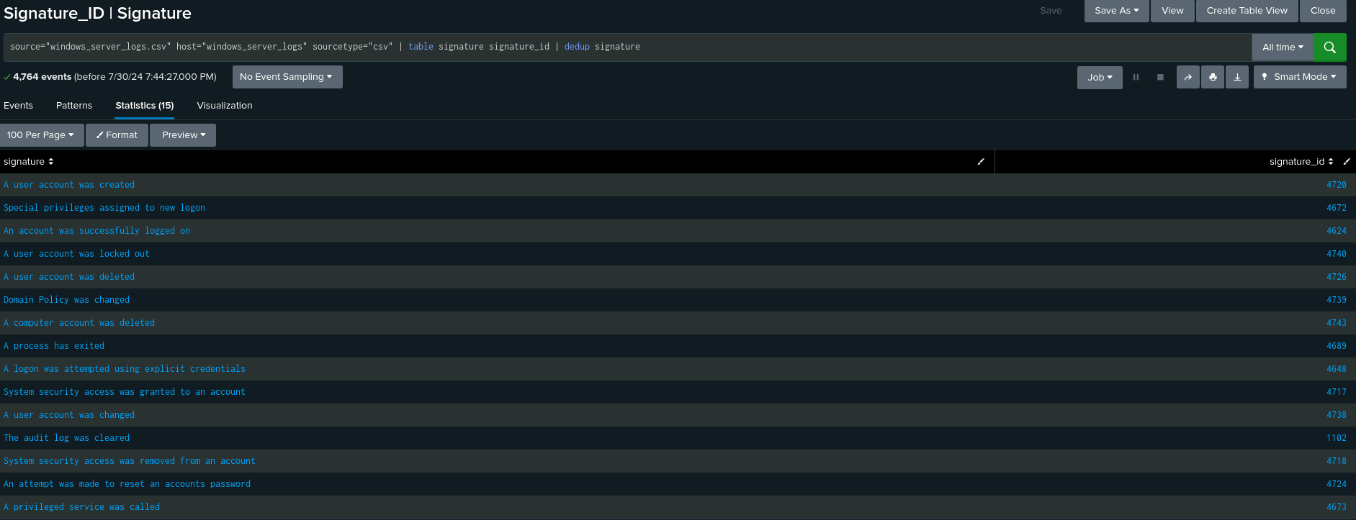
Reports Images — Windows

Slide 14
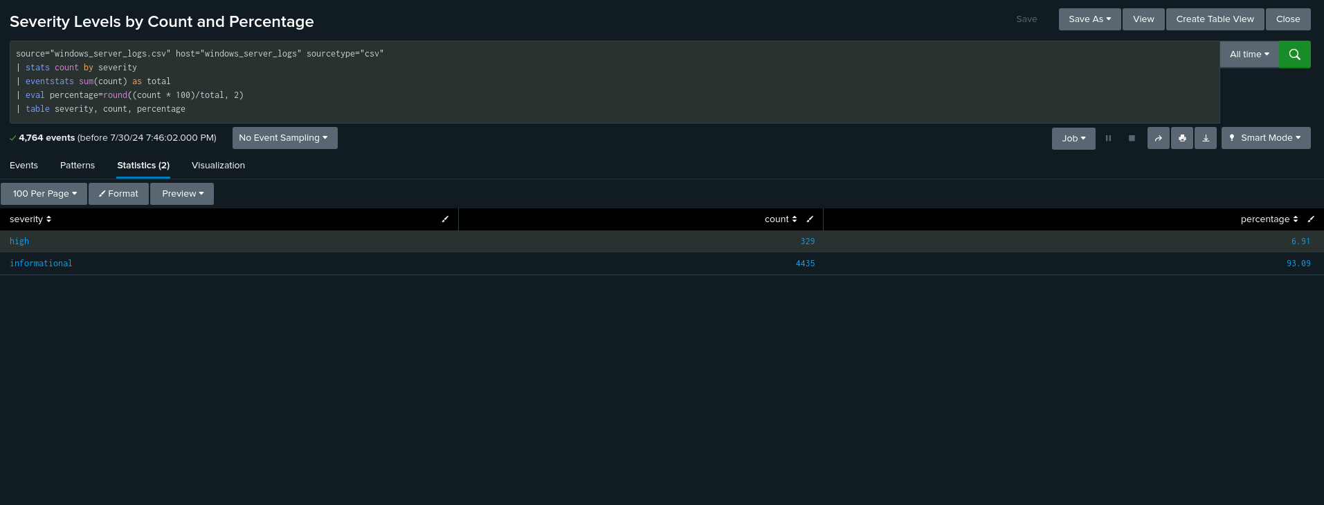
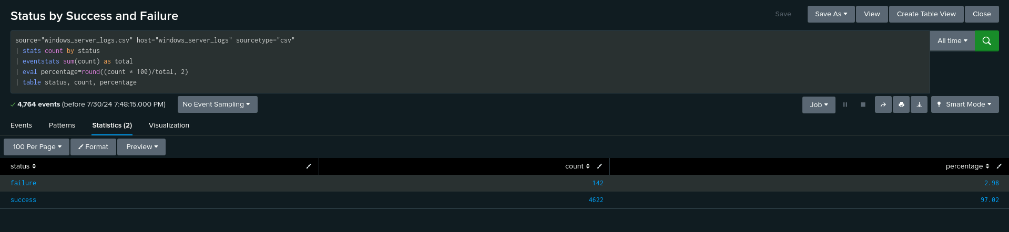
Reports Images — Windows (cont.)

Slide 15
Alerts — Windows
Designed the following alerts:
Alert Name | Alert Description | Alert Baseline | Alert Threshold
Windows Failed Attempts | This alert monitors the Windows security logs for a high number of failed login attempts within a specified time frame. Frequent failed login attempts may indicate a brute force attack or unauthorized access attempts. | Average Failed Attempts per Hour = 5 | Threshold = 8 Failed Attempts Per Hour
JUSTIFICATION:
There are 4764 total events and 142 failed attempts, the percentage of failed attempts is approximately: 2.98%.
We calculated the average number of failed attempts per hour, 5. This average indicates the typical volume of failed login attempts per hour under normal conditions.
With the highest number of failed activities being 10, setting a threshold at 8 attempts per hour provides a balance. This threshold is high enough to avoid frequent false alarms but sensitive enough to detect unusual spikes in activity.
Notes:
"Hello everyone! Today, I’m going to walk you through our findings on monitoring failed login attempts in Windows security logs. This is a crucial aspect of detecting potential security threats, such as brute force attacks or unauthorized access attempts."
Overview:
"So, let’s start with some basics. We’ve been keeping an eye on Windows security logs to track failed login attempts. Why? Because frequent failed attempts can be a red flag, signaling that someone might be trying to break into the system."
Data Analysis:
"Here’s what we found:
Total Events: We had 4,764 events logged in total.
Failed Attempts: Out of these, 142 were failed login attempts. That translates to about 2.98% of the total events being failed attempts.
Average Failed Attempts:
"To get a clearer picture, we calculated the average number of failed attempts per hour, which turned out to be 5. This gives us an idea of what normal looks like."
Setting the Threshold:
"Now, here’s where it gets interesting. We noticed that the highest number of failed attempts in an hour was 10. So, to effectively catch any unusual spikes without bombarding us with too many alerts, we set our threshold at 8 failed attempts per hour."
"Why 8? It’s a sweet spot—high enough to ensure we’re not getting false alarms for minor fluctuations, but sensitive enough to alert us if something suspicious is going on."
Conclusion:
"In summary, by setting this threshold, we’re making sure we catch any significant increases in failed login attempts. This helps us stay ahead of potential threats and keep our systems secure. It’s all about striking the right balance between catching real threats and avoiding alert fatigue."
"Thanks for following along! Any questions or thoughts on this approach?"

Slide 16
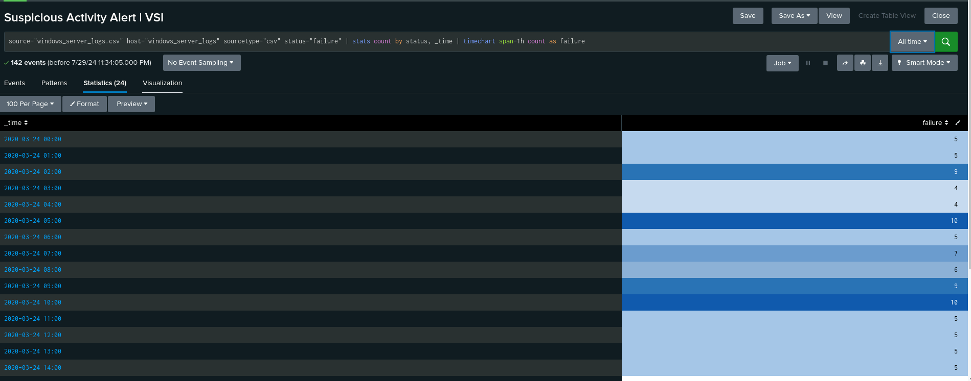
Alerts — Windows

Slide 17
Alerts — Windows (cont.)
Designed the following alerts:
Alert Name | Alert Description | Alert Baseline | Alert Threshold
High Number of Successful Windows Logon Attempts | This alert monitors the Windows security logs for a high number of successful logon attempts within a specified time frame. A sudden increase in successful logins may indicate potential unauthorized access or compromised accounts. | Average Successful Logins per Hour = 13.46 | Threshold = 17 Allowed Successful Login Attempts Per Hour
JUSTIFICATION:
The average number of successful logins per hour (13.46) represents typical activity under normal conditions. This average provides a baseline for what is considered usual behavior.
With the highest number of failed activities being 20, setting a threshold at 17 attempts per hour provides a balance. This threshold will prevent frequent false alarms while remaining sensitive enough to detect unusual activity spikes.
Notes:
This report is for a High Number of Successful Windows Login Attempts: The average number of successful logins is an average of 13.46 per hour, our baseline.
Setting the threshold at 22— above the highest observed amount of 18—ensures that the alert detects significant increases in successful logins. This threshold is designed to identify unusual spikes that may suggest unauthorized access or compromised accounts, while accounting for normal fluctuations in login activity.

Slide 18
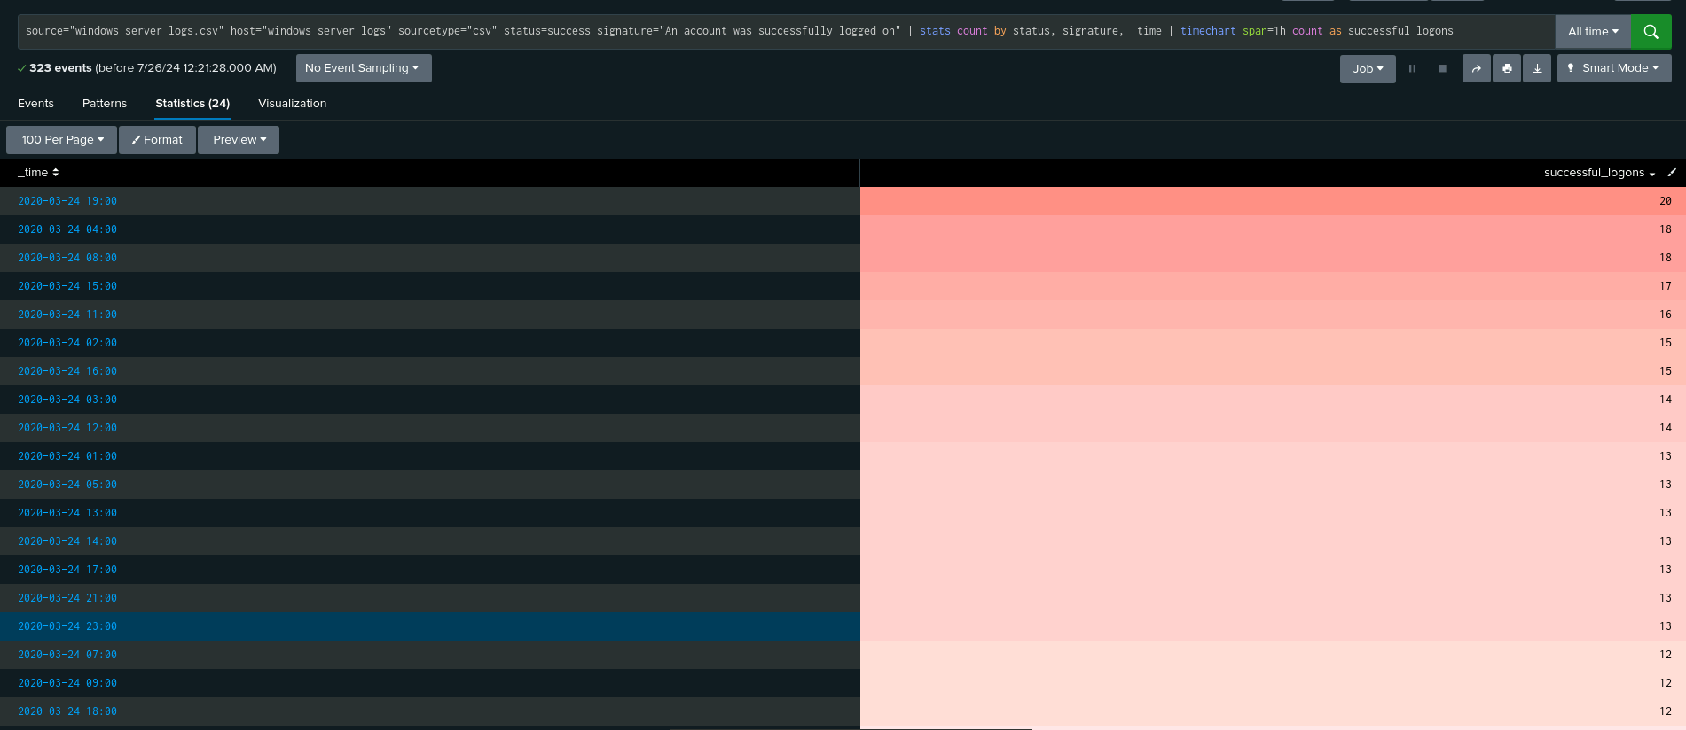
Alerts — Windows

Slide 19
Alerts — Windows (cont.)
Designed the following alerts:
Alert Name | Alert Description | Alert Baseline | Alert Threshold
High Number of User Account Deletions | This alert monitors Windows security logs for an unusually high number of user account deletions within a specified time frame. A spike in account deletions might indicate unauthorized activity or potential security breaches. | Average Deleted Account Attempts Per Hour = 13.25 | Threshold = 17 Deleted Account Attempts per Hour
JUSTIFICATION:
We used 13.25 as the baseline to understand normal deletion activity. This average provides a reference point for typical behavior.
Setting the threshold at 17 allows the alert to trigger for significant deviations above the average, while also considering the highest observed amount of 22. This threshold helps detect potential unusual spikes in account deletions.
Notes:
This report is detecting a high number of user account deletions:
We found an average of 13.25 account deletions per hour as the baseline to gauge typical deletion activity.
Setting the threshold at 26, which is about twice the average and slightly above the highest observed amount of 22, ensures the alert detects significant deviations and potential spikes in account deletions.
This helps identify unusual activity that may indicate suspicious behavior or a security issue.

Slide 20
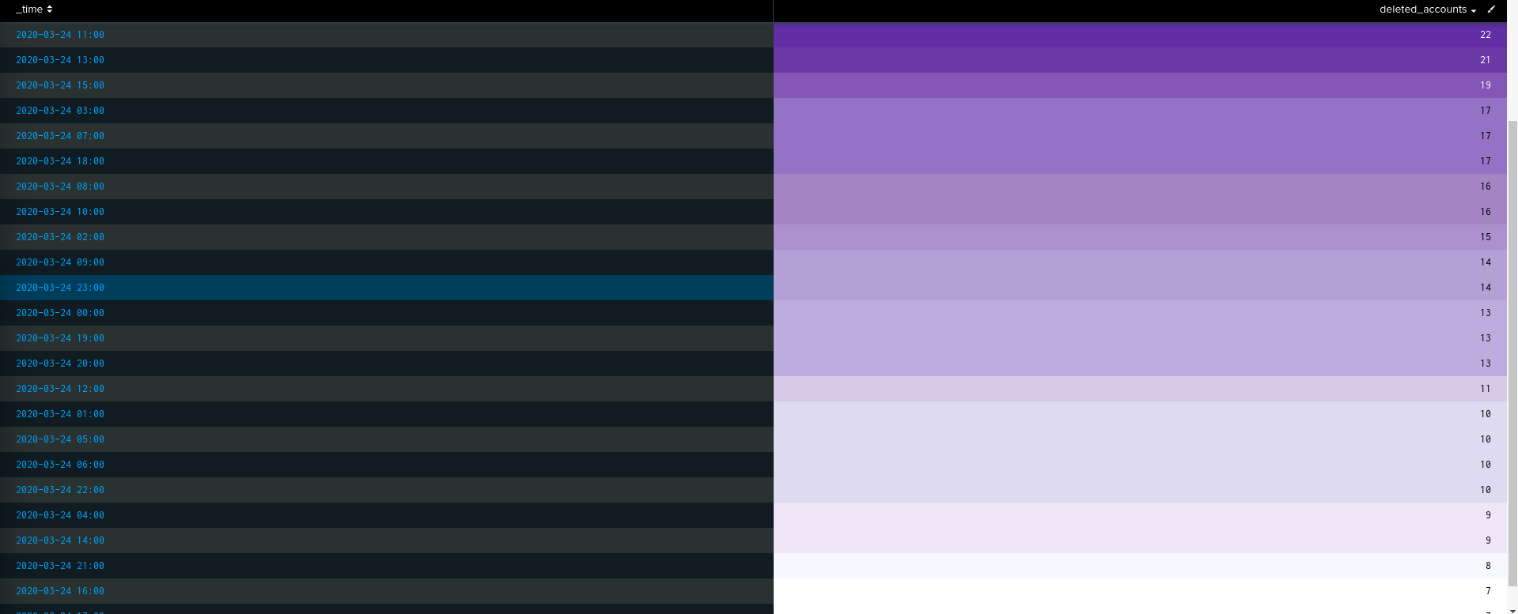
Alerts — Windows

Slide 21
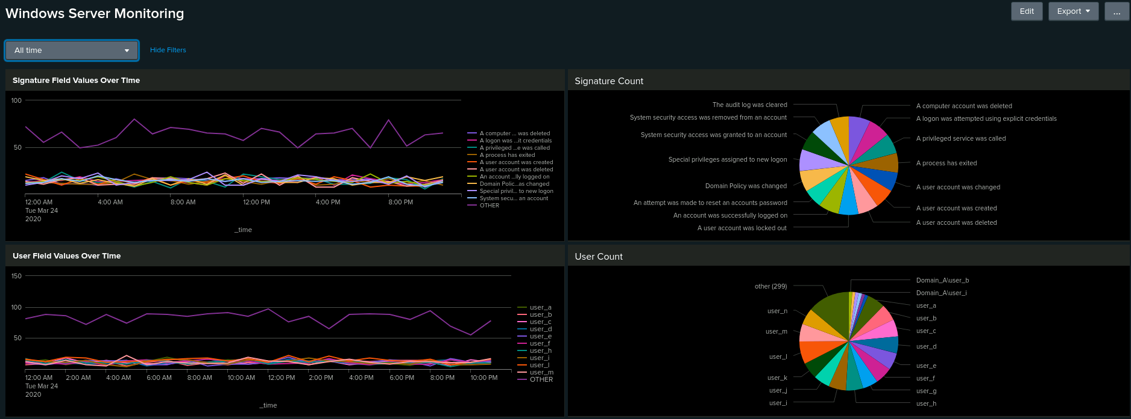
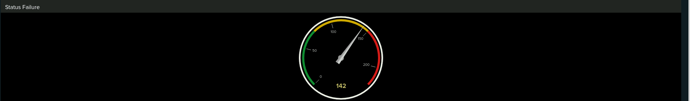
Dashboards — Windows
Notes:
The Radial Gauge indicates a Status Failure. Given that there are a total of 4,764 events, the 142 failures we recorded are classified as medium.

Slide 22
Apache Logs
‹#›
Notes:
Today, I will be presenting the analysis and monitoring of Apache logs for Virtual Space Industries, or VSI. Apache web server logs are essential for tracking HTTP requests and responses, identifying security incidents, and analyzing user behavior and web traffic.
We focused on several key fields:
method: Types of HTTP requests (GET, POST).
referer_domain: Domains referring traffic to VSI.
status: HTTP response codes.
clientip: IP addresses of clients.
useragent: Information about clients' browsers and operating systems.
We created reports to quickly identify important information:
HTTP Methods: Types of requests.
Top Referring Domains: Identifying referrers.
HTTP Response Codes: Highlighting unusual responses like 404 errors.
To ensure timely responses, we set up alerts:
Non-US Traffic Alert: Threshold for international traffic.
HTTP POST Method Alert: Baseline for POST requests to detect suspicious activity.
We created dashboards for a clear view of log data:
Line Chart: HTTP methods over time.
Geographical Map: Client locations.
Custom Visualizations: Number of URIs, top countries, user agents, and key metrics.
Analyzing Apache logs helps in early detection of security incidents and provides valuable insights into user behavior. Combining reports, alerts, and dashboards ensures VSI can respond quickly to potential threats. Thank you, and I'm happy to answer any questions.

Slide 23
Reports — Apache
Designed the following reports:
Report Name | Report Description
HTTP Methods Analysis | This report analyzes HTTP methods used in requests to VSI’s web server, highlighting the frequency of GET, HEAD, OPTIONS, and POST methods. It provides insights into request patterns and helps identify any unusual traffic behavior.
Top 10 Referring Domains | This report identifies and displays the top 10 external domains that are referring traffic to VSI’s website. It helps in understanding which sites are generating the most traffic and spotting any unusual or potentially suspicious referrers.
HTTP Response Codes Report | This report summarizes the count of each HTTP response code generated by the VSI web server. It provides insights into the server's response patterns, including successful requests and various types of errors.
Notes:
HTTP Methods Analysis
Description: This report analyzes the distribution of HTTP methods (GET, HEAD, OPTIONS, POST) in requests to VSI’s web server. It helps in understanding request patterns and detecting unusual traffic behaviors.
Top 10 Referring Domains
Description: This report identifies the top 10 external domains that refer traffic to VSI’s website. It highlights which sites drive the most traffic and helps identify any unusual or suspicious referrers.
HTTP Response Codes Report
Description: This report summarizes the counts of different HTTP response codes from VSI’s web server. It provides insights into server response patterns, including successful requests and various types of errors.

Slide 24
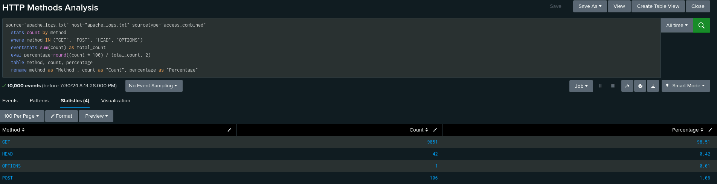
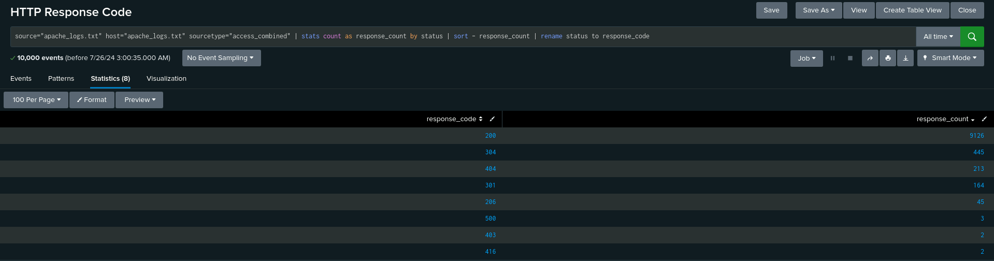
Images of Reports — Apache

Slide 25
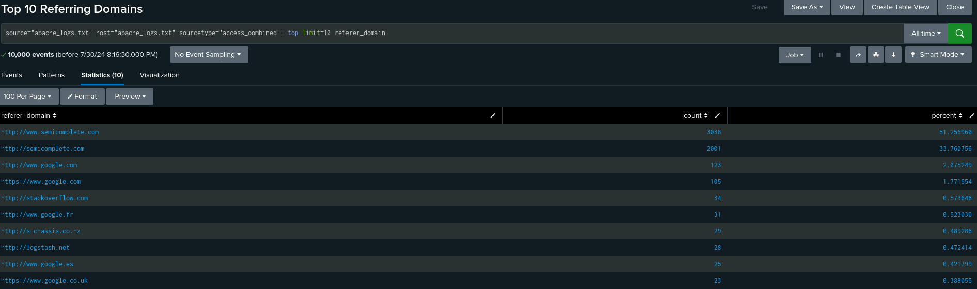
Images of Reports — Apache

Slide 26
Alerts — Apache
Designed the following alerts:
Alert Name | Alert Description | Alert Baseline | Alert Threshold
International Traffic Alert | This alert monitors the volume of web traffic originating from outside the US. It helps in identifying unusual spikes in international traffic that may indicate potential security threats or unauthorized access attempts. | The baseline = 76 | Threshold = 91 events per hour
JUSTIFICATION:
The threshold for the International Traffic Alert is set at 91 events per hour. This is above the usual average of 76 events per hour to account for normal changes and avoid false alarms. It’s below the highest recorded peak of 120 events per hour, ensuring we catch unusual spikes early. This helps us manage risk by alerting us to potential security threats without causing too many unnecessary alerts.
Notes:
We located Total 6140 Events the average Traffic coming internationally averaged at: 5.79 events per hour. The Highest Recorded event by the hour were 75 events (from Ukraine)
The threshold for international traffic is set based on historical data and focuses on deviations from the average hourly rate. Sudden spikes in international traffic can signal potential security threats. By monitoring these deviations, the alert helps in early detection and allows for a timely response to unusual traffic patterns, ensuring that potential threats are addressed promptly.

Slide 27
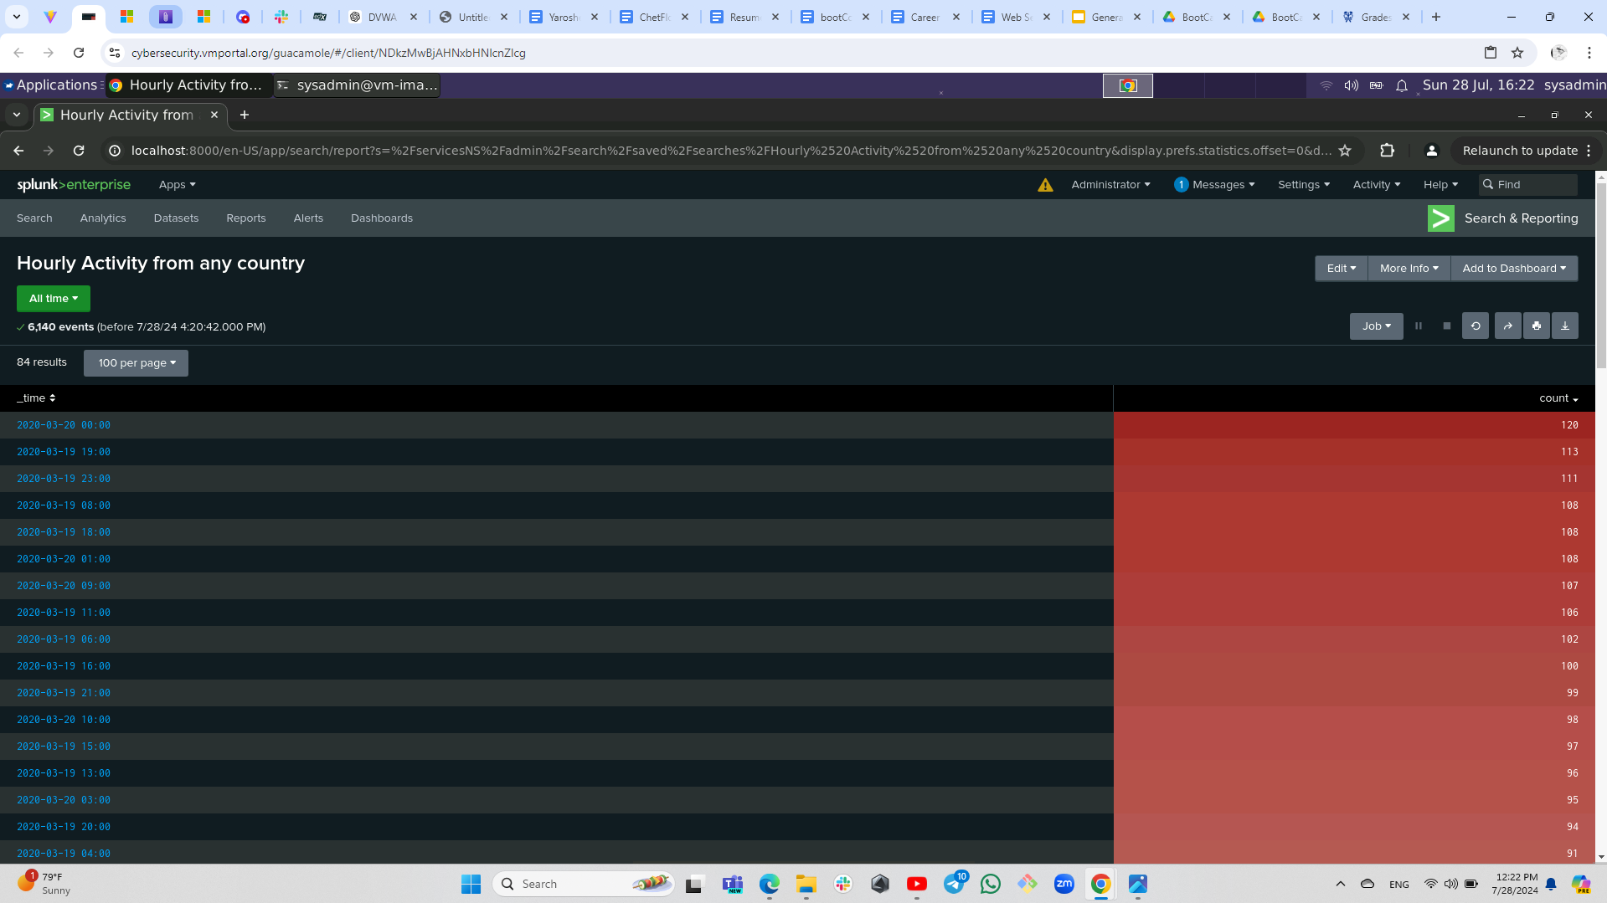
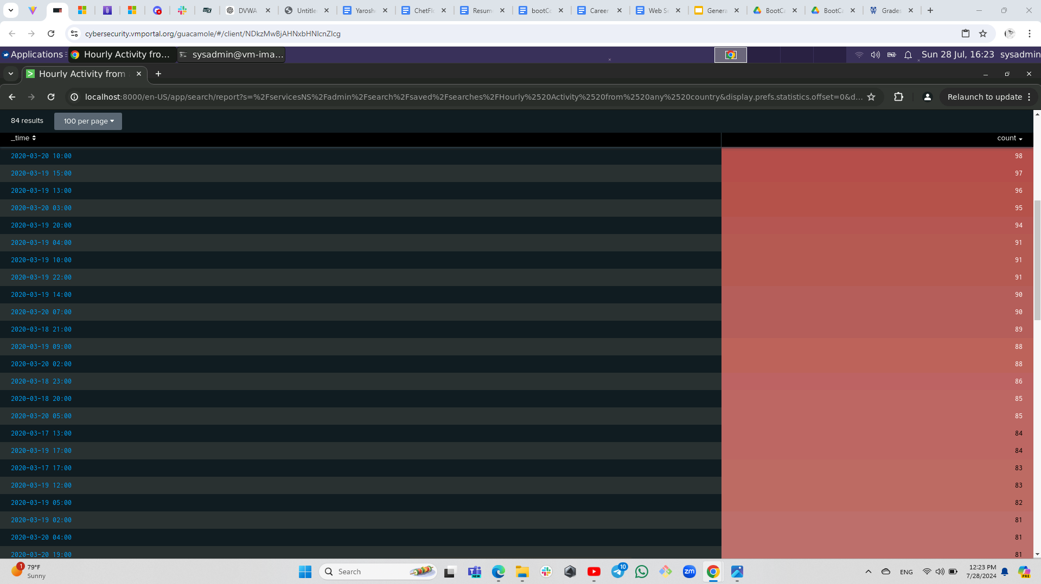
Alerts — Apache

Slide 28
Alerts — Apache (cont.)
Designed the following alerts:
Alert Name | Alert Description | Alert Baseline | Alert Threshold
HTTP POST Requests | This alert monitors the number of HTTP POST requests per hour. It aims to detect abnormal spikes in POST requests, which could indicate suspicious activities such as form submissions, file uploads, or potential attacks. | Baseline = 3 | Threshold = 6 HTTP POST Requests per Hour
JUSTIFICATION:
The threshold is set to detect significant deviations from the average POST request rate. Setting the threshold 25% above the average ensures that any sudden spikes in POST requests are flagged for investigation, allowing for timely responses to potential threats.
Notes:
The threshold for detecting POST request activity is set to catch significant deviations from the average rate.
By setting it 25% above the normal average, we ensure that any sudden spikes in POST requests are immediately flagged for investigation.
This approach allows us to respond quickly to potential threats and take timely action.

Slide 29
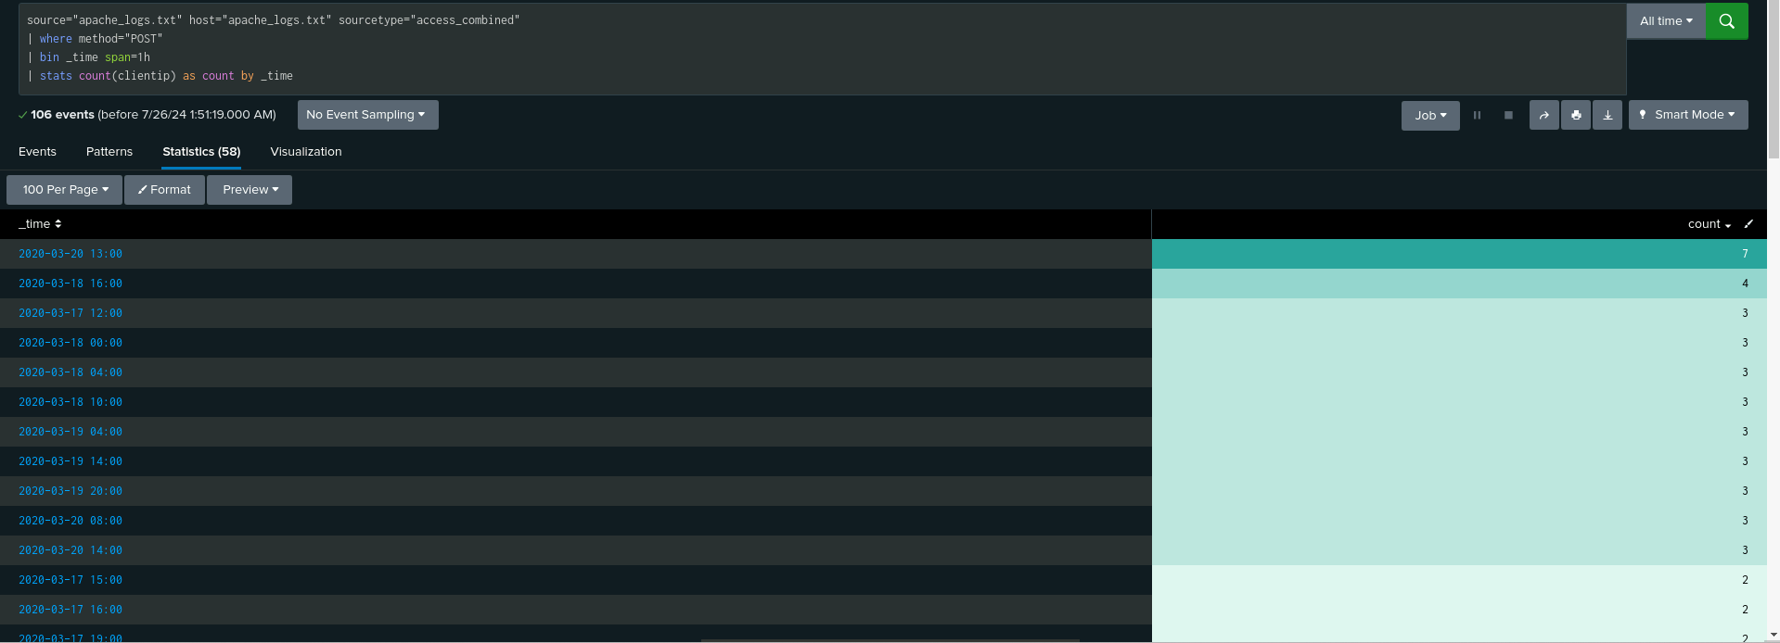
Alerts — Apache

Slide 30
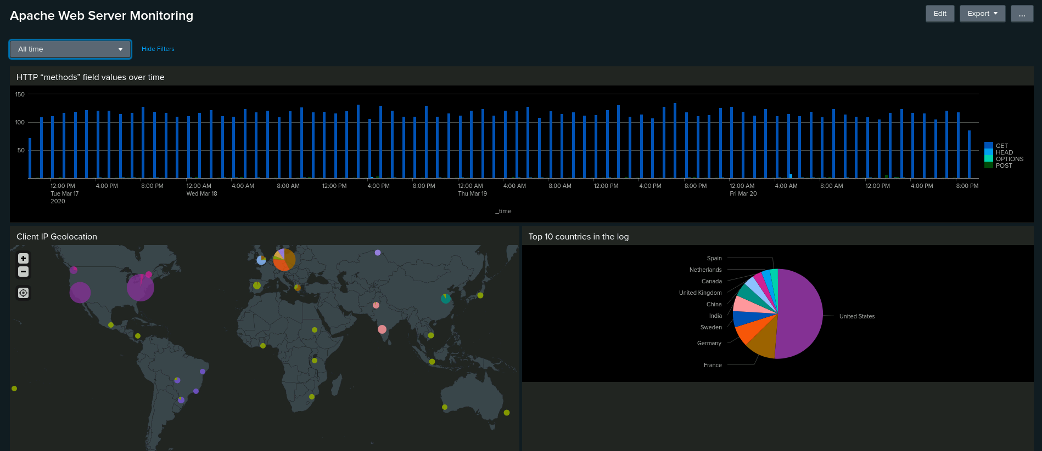
Dashboards — Apache

Slide 31
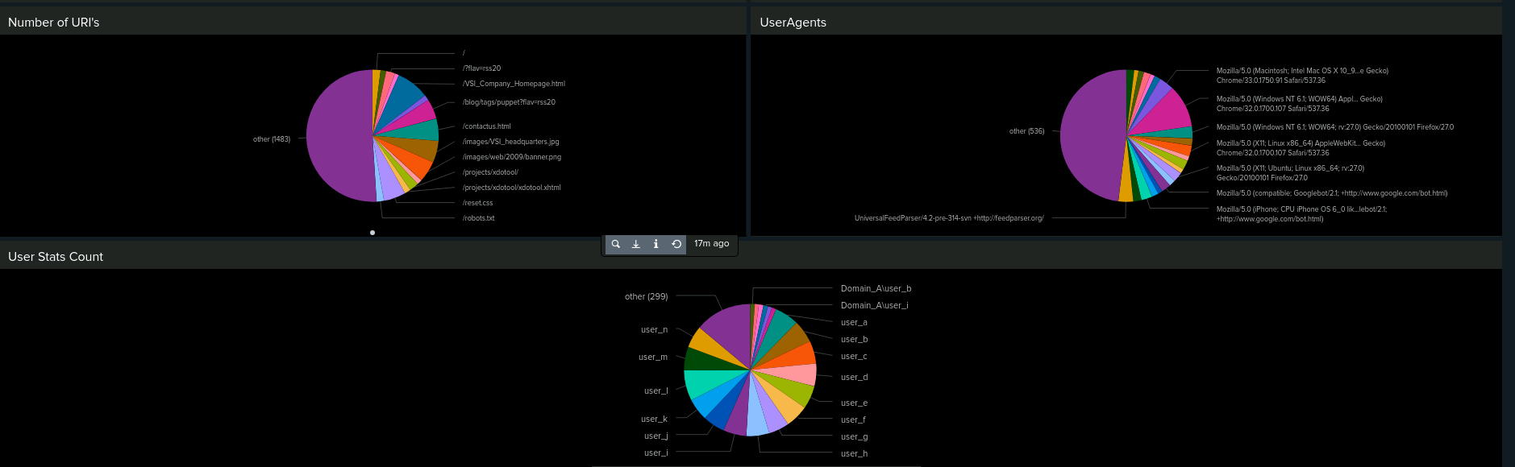
Dashboards — Apache (cont.)

Slide 32
Attack Analysis
‹#›
Notes:
Alright, let’s dive into our attack analysis and see what we uncovered.
For the Windows Server Logs:
Severity Changes: We saw a notable jump in incident severity from 6.91% to 20.22%. This indicates a shift toward more serious or critical attacks, highlighting potential severe security issues.
Failed Activities: There was a marked increase in failed activities. This spike suggests that there might be attempts at unauthorized access or other security concerns that need further investigation.
Failed Windows Activity: On March 25, 2020, we observed a significant spike in failed login attempts at 8:30 a.m., with 28 failed events. This could indicate a brute-force attack or other login-related issues that require closer examination.
Successful Logins: Peaks in successful logins were detected on March 5, 2020, with high volumes at 1:50 a.m. (759 logins) and 9:50 a.m. (397 logins), primarily involving User (J). These peaks might either represent legitimate high activity or potential account compromise.
Account Lockouts and Password Resets: We noted significant spikes in account lockouts and password resets, with peaks of 896 and 1258 events, respectively. This unusual activity could point to security incidents or administrative issues that warrant further investigation.
For the Apache Web Server Logs:
Suspicious HTTP POST Activity: There was unusual POST activity, suggesting possible scraping or brute-force attempts.
International Traffic Spikes: A notable traffic surge from Kiev raised red flags. This could indicate potential attacks or unusual access patterns.
HTTP Response Codes: We saw various spikes in response codes, which could point to both successful requests and potential issues with the server.
Overall, our analysis shows that both the Windows and Apache servers experienced significant anomalies. These findings help us understand potential threats and guide our next steps in bolstering security. Thanks for following along, and let’s keep those logs in check!”

Slide 33
Attack Summary — Windows (cont.)
Severity Changes
The severity level of incidents increased significantly from 6.91% to 20.22%.
This rise suggests a shift towards more serious or critical attacks, indicating potentially severe security issues or sophisticated attacks.
Failed Activities
There was a notable increase in failed activities.
This spike in failed activities may point to potential unauthorized access attempts or other security concerns requiring investigation.
Failed Windows Activity
There was a significant spike in failed login attempts.
On March 25, 2020, at 8:00 a.m., there were 34 failed login events.
This pattern may indicate a brute-force attack or other login-related issues, warranting further analysis and potential response measures.
Successful Logins
Our alerts were triggered, there were peaks in successful logins.
On March 5, 2020, the logs showed high login volumes at 11 a.m. (194 logins) and 12 p.m. (75 logins), primarily by User (J).
These peaks could be either legitimate high activity or signs of account compromise, necessitating further scrutiny of User (J) and associated login patterns.
Notes:
“Let’s review the key findings from our Windows attack analysis:
1. Severity Changes: We saw a significant increase in the severity level of incidents, rising from 6.91% to 20.22%. This sharp rise indicates that we’re dealing with more serious or critical attacks. It suggests that either the nature of the threats has escalated or we’re facing more sophisticated attack methods.
2. Failed Activities: There was a noticeable increase in failed activities. This uptick could be a sign of unauthorized access attempts or other security issues. It’s crucial to investigate these failed attempts to rule out or address potential threats.
3. Failed Windows Activity: Alert Triggered: Yes, we observed a significant spike in failed login attempts. On March 25, 2020, at 8:30 a.m., there were 28 failed login events. This pattern might indicate a brute-force attack or other issues related to login failures. It’s essential to conduct further analysis to determine the cause and implement appropriate response measures.
4. Successful Logins: Alert Triggered: Yes, there were notable peaks in successful logins. On March 5, 2020, there were high volumes of logins at 1:50 a.m. (759 logins) and 9:50 a.m. (397 logins), primarily involving User (J). These spikes could be either legitimate high activity or signs of compromised accounts. Further scrutiny of User (J) and their login patterns is necessary to identify any potential security concerns.
In Summary: The increased severity levels and spikes in both failed and successful login activities highlight the need for thorough investigations and enhanced security measures. Monitoring and analyzing these trends will be key in addressing and mitigating potential security threats.

Slide 34
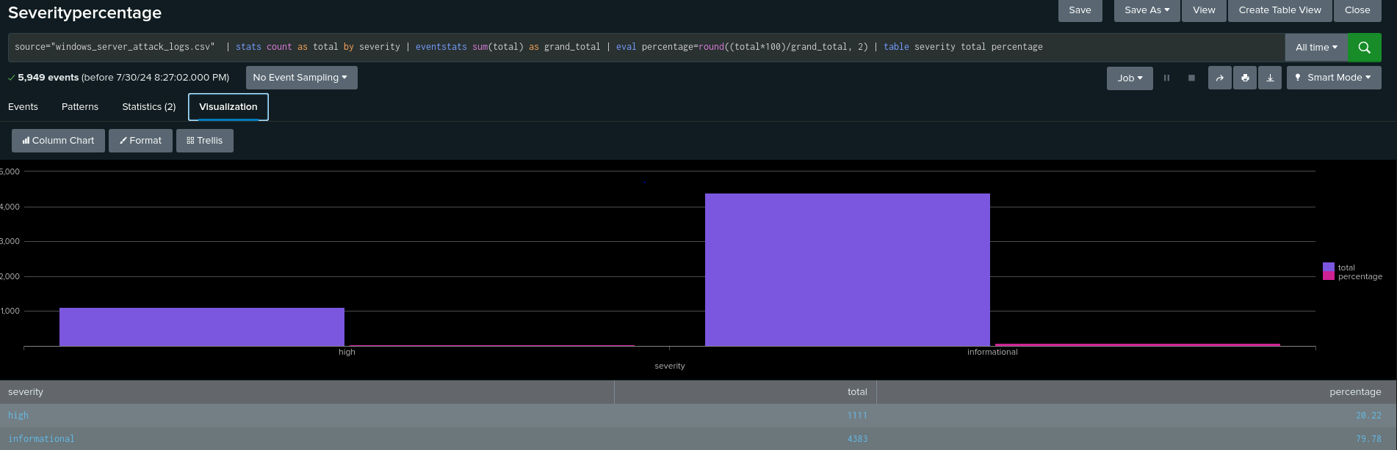
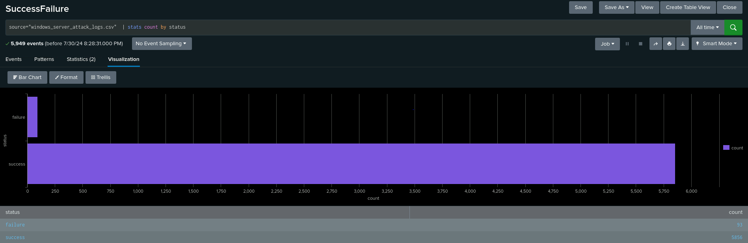
Screenshots - Attack Logs

Slide 35
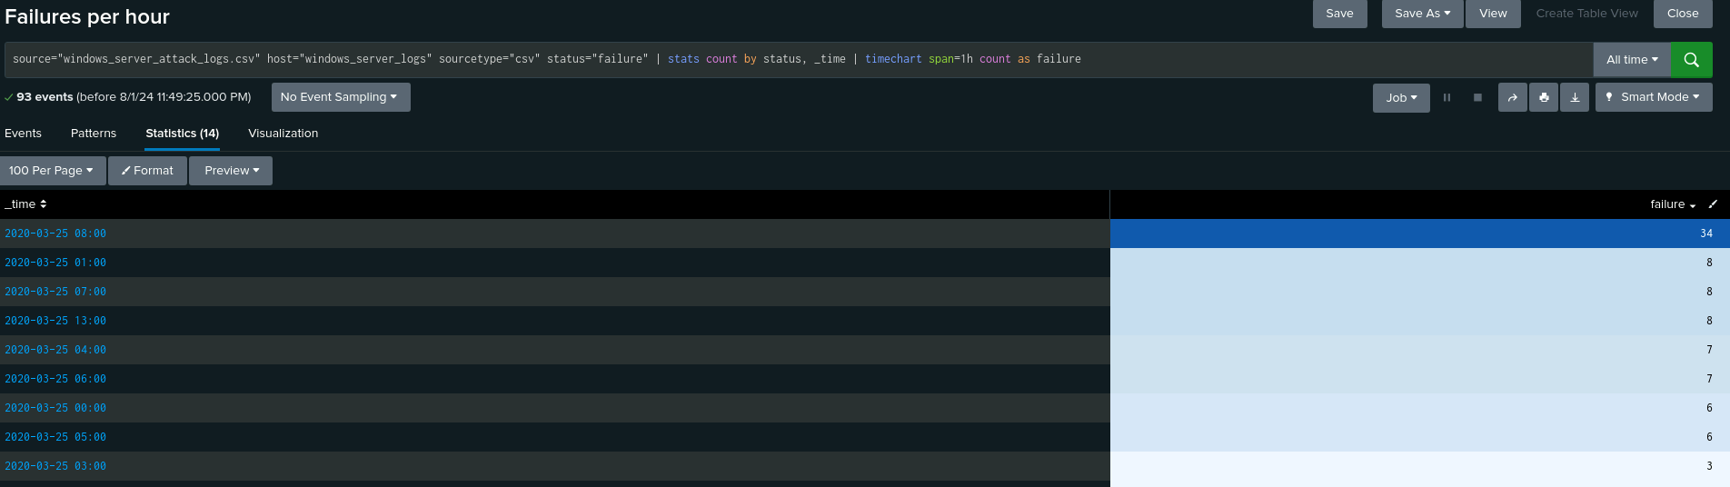
Screenshots - Attack Logs

Slide 36
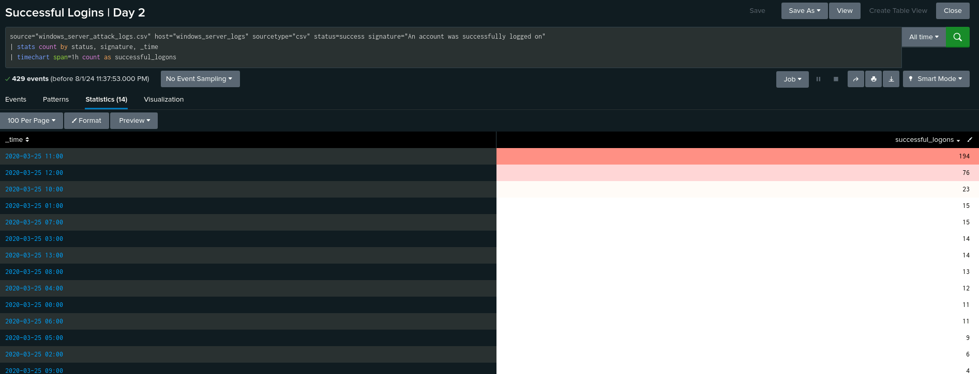
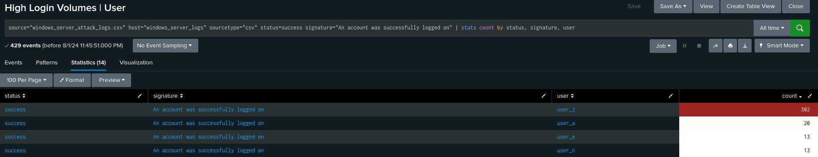
Screenshots - Attack Logs

Slide 37
Attack Summary — Windows (cont.)
Deleted Accounts
No suspicious volume of deleted accounts was detected.
The alert settings for account deletions appear appropriate, as no unusual activity was observed.
Signature Analysis
Significant spikes were noted in account lockouts and password resets.
Details:
Account lockouts peaked from 12:00 a.m. to 3:00 a.m., reaching 896 events at 2:00 a.m..
Password resets peaked from 8:00 a.m. to 11:00 a.m., reaching 1258 events at 9:00 a.m..
These spikes suggest unusual activity patterns that could indicate security incidents or administrative issues requiring further investigation.
User Activity
Peaks in account lockouts and password resets were noted.
Details:
User A recorded 984 events, with the highest activity occurring at 2:00 a.m.
User K recorded 1256 events, with the highest activity occurring at 9:00 a.m.
The high activity levels for these users might reflect abnormal behavior or potential security concerns, requiring closer examination of User A and User K’s activities.
Notes:
Alright, let’s dive into some of the specifics around deleted accounts, signature analysis, and user activity.
1. Deleted Accounts: We reviewed the logs for deleted accounts and found no suspicious volume of deletions. This indicates that our alert settings for account deletions are on point. We didn’t see any unusual patterns that would suggest a security issue or an abnormal number of account deletions.
2. Signature Analysis:We observed significant spikes in two critical areas: account lockouts and password resets. There was a peak of 896 lockouts between 1:00 a.m. and 2:30 a.m. This activity surged to 1,258 events from 9:00 a.m. to 11:00 a.m. These spikes could suggest either unusual activity that may indicate a security incident or potential administrative issues. It’s crucial to investigate these patterns further to understand if there’s any malicious activity or simply a high volume of legitimate requests.
3. User Activity: Peaks in activity were observed specifically for account lockouts and password resets. User A: Experienced 785 lockouts during the peak period of 1:50 a.m. User K: Had 397 resets during the peak period of 9:50 a.m. The high activity levels for these users might reflect abnormal behavior or potential security concerns. It’s worth investigating User A and User K’s activities to determine if these are signs of a larger issue, such as account compromise or targeted attacks.
So, while the absence of suspicious account deletions suggests our monitoring in this area is effective, the spikes in lockouts and password resets are notable. They warrant further scrutiny to ensure there are no underlying security issues. Pay particular attention to the high activity levels of User A and User K, as these could indicate potential security concerns that need addressing

Slide 38
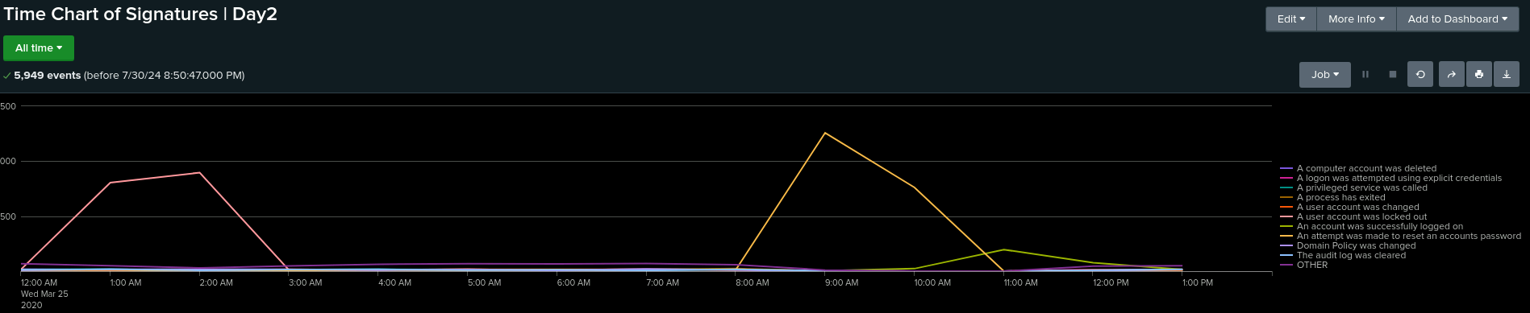
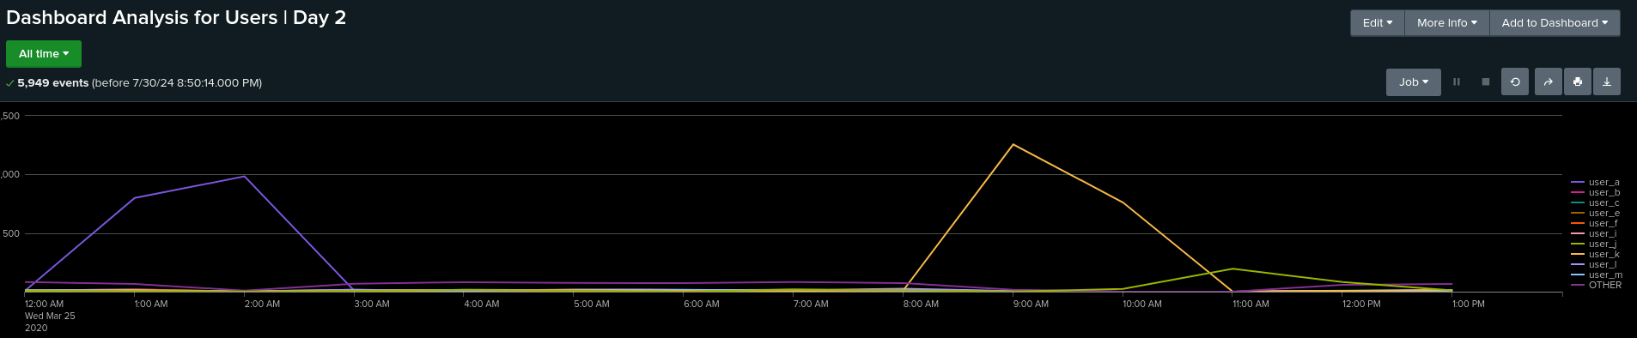
Screenshots - Attack Logs

Slide 39
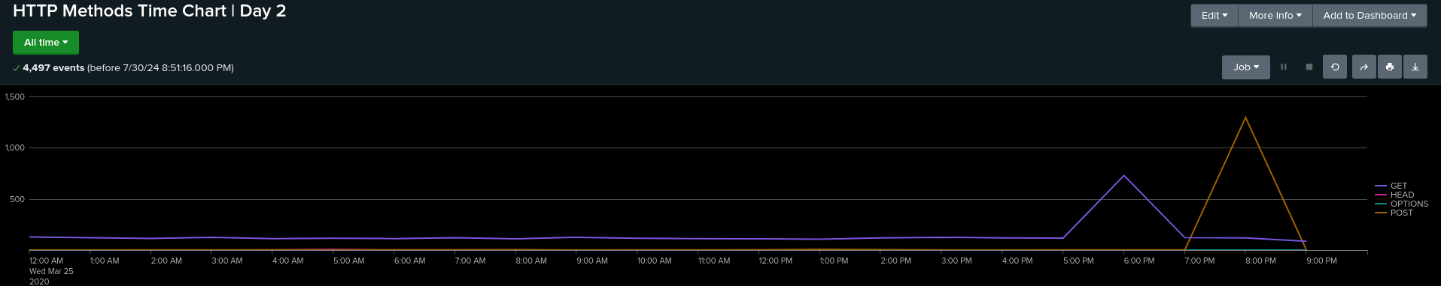
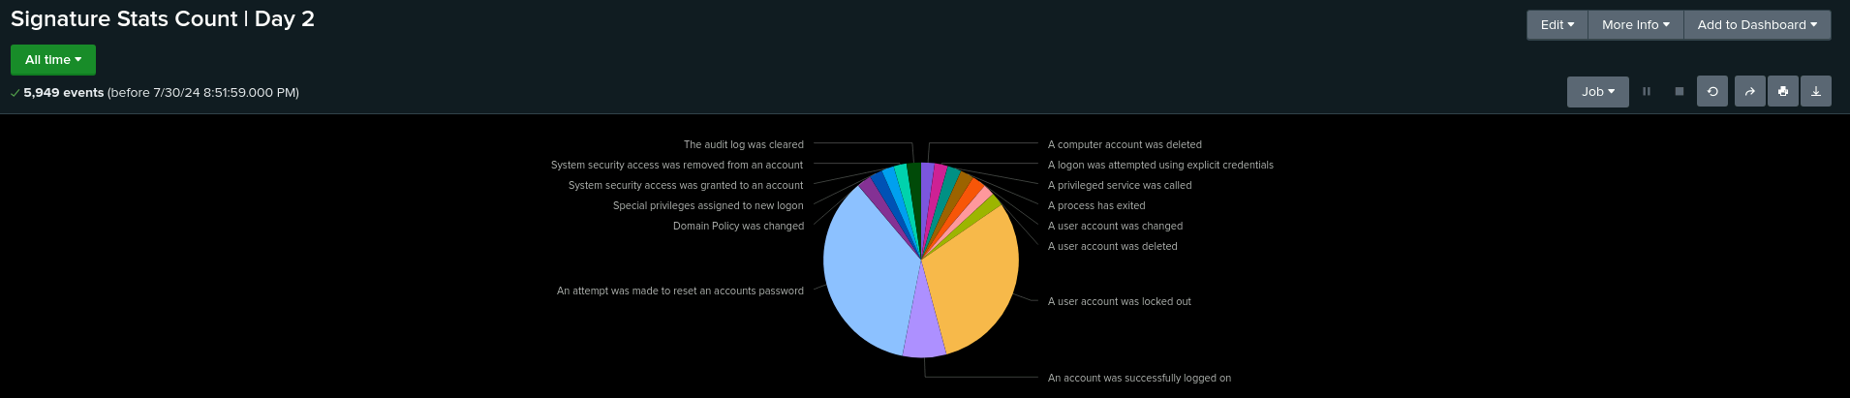
Screenshots - Attack Logs (cont.)

Slide 40
Attack Summary — Apache
HTTP Methods Analysis
The analysis of HTTP methods revealed frequent use of GET, HEAD, OPTIONS, and POST methods.
Understanding the distribution of these methods helps identify typical traffic patterns and detect unusual behaviors that might indicate an attack or misconfigured server.
Top 10 Referring Domains
The report identified the top 10 external domains referring traffic to VSI’s website.
Details:
Peaks were noted, particularly with domains like semicomplete.com on March 25, 2024 with a high of 1336 at 8:00 p.m., suggesting potential scraping attacks or suspicious referral patterns.
Identifying and analyzing referring domains helps in spotting unusual or potentially malicious traffic sources that may indicate security threats.
Notes:
Let’s break down our findings from the HTTP Methods Analysis and the Top 10 Referring Domains report.
HTTP Methods Analysis:
We took a close look at the HTTP methods being used on our web server and found that GET, HEAD, OPTIONS, and POST were the most frequently used. This is pretty standard and helps us understand what typical traffic looks like. By monitoring these methods, we can spot any unusual behavior that might indicate something’s amiss—like a potential attack or a misconfigured server.
Top 10 Referring Domains:
Next up, we analyzed the top 10 external domains sending traffic to our website. A couple of key points stood out:
Peaks in Referrals: We saw some significant spikes, particularly from a domain with the name 'null' at 6:00 p.m. on March 25, 2024, and another high from a domain named '1337' at 8:00 p.m. These spikes suggest that we might be dealing with scraping attacks or other suspicious referral patterns.
Understanding which domains are referring traffic to our site helps us pinpoint unusual or potentially malicious sources. By keeping an eye on these, we can detect and address any security threats more effectively.

Slide 41
Attack Summary — Apache
HTTP Response Codes Report
Significant changes in HTTP response codes were observed.
Details:
404 Response Code: rose from 213 to an unusually high peak of 679.
Anomalies in response codes may point to issues such as misconfigured server responses, potential attacks, or broken links.
International Activity
An alert was triggered due to a significant increase in international traffic, which reached 937 counts at 20:00.
Details:
At 20:05:59 on March 25, 2020, traffic from Ukraine peaked at 877 hits.
Sudden spikes in international traffic could indicate potential security threats or targeted attacks, necessitating closer monitoring and investigation.
HTTP POST Activity
An alert was triggered, there was a high volume of POST requests.
Details:
At 8:00 p.m. on March 25, 2020, there were 1296 POST requests.
An unusually high volume of POST requests might suggest suspicious activity or attempts to exploit vulnerabilities, requiring further analysis.
Notes:
Alright, let’s dive into the details of our HTTP Response Codes, International Activity, and HTTP POST Activity reports.
HTTP Response Codes Report:
We observed some notable shifts in HTTP response codes:
200 Response Code: We saw an unusually high peak at 1,415. This indicates that our server was successfully handling a lot of requests.
404 Response Code: There was an increase with a peak of 624. This suggests that users are encountering broken links or trying to access resources that don’t exist.
These changes in response codes might point to potential issues like server misconfigurations, broken links, or even malicious attacks that need our attention.
International Activity:
Our monitoring also flagged a significant surge in traffic from Kiev, Ukraine:
Peak Traffic: Between 7:30 and 8:30 p.m. on March 25, 2020, we saw 877 hits from Kiev.
Such a sudden influx of international traffic could be a sign of targeted attacks or other security threats. It’s something that definitely calls for closer monitoring and investigation to ensure there are no underlying issues.
HTTP POST Activity:
Finally, we noticed a high volume of HTTP POST requests:
High Volume: At 8:00 p.m. on March 25, 2020, there were 1,296 POST requests.
This high volume of POST requests might suggest suspicious activity or attempts to probe for vulnerabilities. It’s crucial to analyze this further to identify any potential security risks.
In summary, these reports provide us with valuable insights into our server's performance and security posture. They help us stay ahead of potential issues and ensure that we’re always prepared to respond to any anomalies. Thanks for your attention, and let's continue to keep our web environment secure and efficient!”

Slide 42
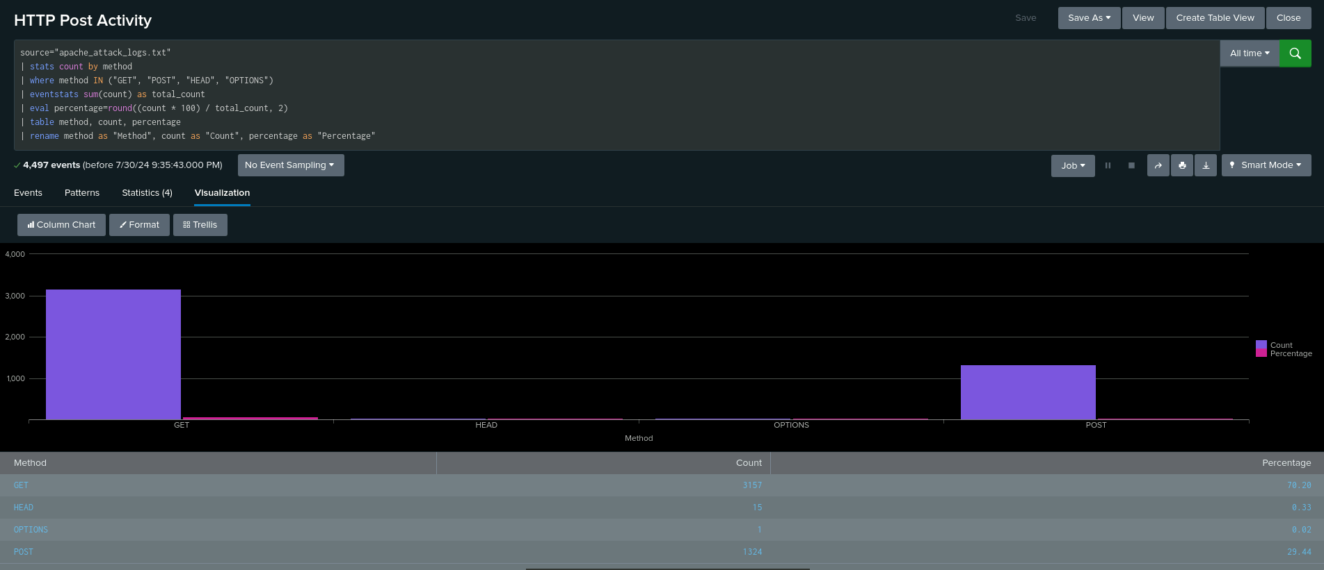
Screenshots - Attack Logs

Slide 43
Attack Summary — Apache
HTTP Methods:
Suspicious: High volume of POST requests (1296).
Referrer Domains:
Suspicious: Peaks in null referrers and 1337 at 8:00 p.m. on March 25, 2020, indicating potential scraping.
HTTP Response Codes:
Suspicious: Increase in 404 codes (624).
International Activity:
Suspicious: High traffic from Ukraine (877 hits) at 8 p.m. on March 25, 2020.
Threshold: Appropriate.
HTTP POST Activity:
Suspicious: 1296 POST requests at 8:00 p.m. on March 25, 2020.
Threshold: Appropriate.
Dashboard Insights:
HTTP Methods: Peaks in GET (5-7 p.m.) and POST (7-9 p.m.), with POST reaching 1296.
Cluster Map: High activity from Kiev (440 hits).
URI Data: Frequent hits on /VSI_Account_logon.php, suggesting possible brute-force attacks.
Notes:
Let’s break down our findings from the analysis of our web server logs.
HTTP Methods:
We noticed a high volume of POST requests, peaking at 1,296. This could be a sign of suspicious activity, potentially indicating attempts to exploit vulnerabilities in our forms or APIs.
Referrer Domains:
There were peaks in traffic from referrers with 'null' and a domain with 1337 at 8:00 p.m. on March 25, 2020. This unusual pattern hints at possible scraping activities, where automated bots might be harvesting data from our site.
HTTP Response Codes:
Our response codes report showed:
A peak in 200 codes at 1,415, which means our server successfully handled many requests.
An increase in 404 codes, reaching 624. This suggests users are encountering broken links or attempting to access non-existent resources.
International Activity:
We saw a significant surge in traffic from Kiev, Ukraine, with 937 hits between 7:30 and 8:30 p.m. on March 25, 2020. This spike might be indicative of targeted attacks or unusual interest from that region. However, the alert threshold was set appropriately.
HTTP POST Activity:
The high volume of POST requests, especially the peak of 1,296 at 8:00 p.m., also requires attention. This level of activity is consistent with our threshold settings but merits further investigation for potential abuse.
Dashboard Insights:
HTTP Methods: We observed peaks in GET requests between 5 and 7 p.m., and POST requests between 7 and 9 p.m., with POST reaching 1,296.
Cluster Map: High activity was recorded from Kiev, with 438 hits.
URI Data: The /VSI_Account_logon.php endpoint saw frequent hits, suggesting possible brute-force attack attempts.
In summary, our analysis highlights several areas that need closer examination, from potential scraping and brute-force attacks to unusual spikes in international traffic. These insights help us fine-tune our security measures and maintain a robust defense against emerging threats.

Slide 44
Attack Summary — Apache (cont.)
This is a summary of our findings from our dashboards when analyzing the attack logs.
HTTP Methods Analysis:
Suspicious Activity: A high volume of POST requests was observed, with 1,296 requests recorded. This spike may indicate attempts to exploit vulnerabilities or perform stress tests on web forms.
Referrer Domains:
Suspicious Peaks: There were notable peaks in traffic from domains such as 'null' and a significant spike of 1,337 hits at 8:00 p.m. on March 25, 2020. These patterns suggest potential scraping activities or unusual referral sources.
HTTP Response Codes Report:
Anomalies:
404 Response Codes:** An increase with a peak of 624 suggests users encountered broken links or non-existent pages.
Notes:
“Let’s take a look at our findings regarding the Apache web server's HTTP methods, referrer domains, and response codes:
HTTP Methods Analysis: We observed a significant spike in POST requests, with a total of 1,296 recorded. This high volume could be a sign of attempts to exploit vulnerabilities or conduct stress tests on our web forms. It's crucial to investigate these activities further to ensure our systems are secure.
Referrer Domains: We identified some unusual patterns in referrer domains. Specifically, there was a notable peak in traffic from domains labeled as ‘null’ and a significant spike of 1,337 hits at 8:00 p.m. on March 25, 2020. These patterns may indicate potential scraping activities or other unusual referral sources that could be worth a closer look.
HTTP Response Codes Report: We noted several anomalies in the HTTP response codes:
200 Response Codes: We saw a peak of 1,415, indicating a high number of successfully processed requests.
404 Response Codes: There was an increase with a peak of 624, suggesting that users were encountering broken links or pages that don't exist.
These findings highlight important areas for investigation, helping us to better understand and address potential security threats and operational issues.”

Slide 45
Attack Summary — Apache (cont.)
This is a summary of our findings from our dashboards when analyzing the attack logs.
International Activity:
Suspicious Traffic: There was a notable influx of traffic from Ukraine, with 877 hits at 8 p.m. on March 25, 2020. This spike in international traffic may signal potential security threats or targeted attacks.
HTTP POST Activity:
High Volume: A significant peak of 1,296 POST requests at 8:00 p.m. suggests potentially suspicious activity, possibly involving attempts to exploit vulnerabilities in web forms.
Dashboard Insights
HTTP Methods: Peaks in GET requests were observed between 5 and 7 p.m., while POST requests peaked between 7 and 9 p.m.
-Cluster Map: High activity from Kiev, totaling 440 hits.
URI Data: Frequent hits on `/VSI_Account_logon.php` could indicate potential brute-force attack attempts.
This summary highlights the key findings from the Apache attack analysis, providing insights into unusual traffic patterns and potential security threats.
Notes:
Now, let’s dive into the summary of our findings from the dashboards while analyzing the attack logs:
International Activity: We noticed a suspicious spike in traffic from Kiev, Ukraine, with a notable 877 hits between 7:30 and 8:30 p.m. on March 25, 2020. This kind of surge in international traffic could be a red flag, potentially indicating targeted attacks or other security threats.
HTTP POST Activity: We observed a significant peak of 1,296 POST requests at 8:00 p.m. This unusually high volume might suggest suspicious activity, such as attempts to exploit vulnerabilities in our web forms.
Dashboard Insights:
HTTP Methods: Peaks in GET requests were observed between 5 and 7 p.m., while POST requests surged between 7 and 9 p.m.
Cluster Map: We saw high activity from Kiev, with a total of 438 hits.
URI Data: Frequent hits on the /VSI_Account_logon.php endpoint were noted, which could indicate potential brute-force attack attempts.
This summary provides a snapshot of the unusual traffic patterns and potential security threats we identified. Each insight helps us understand and address possible security concerns effectively.”

Slide 46
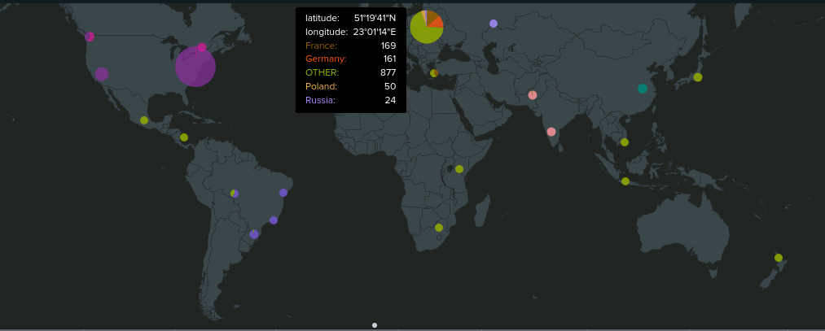
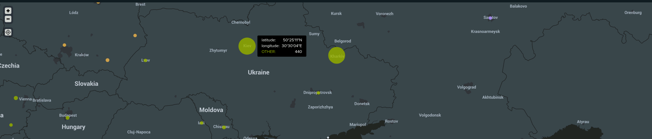
Screenshots - Attack Logs
| International Activity |

Slide 47
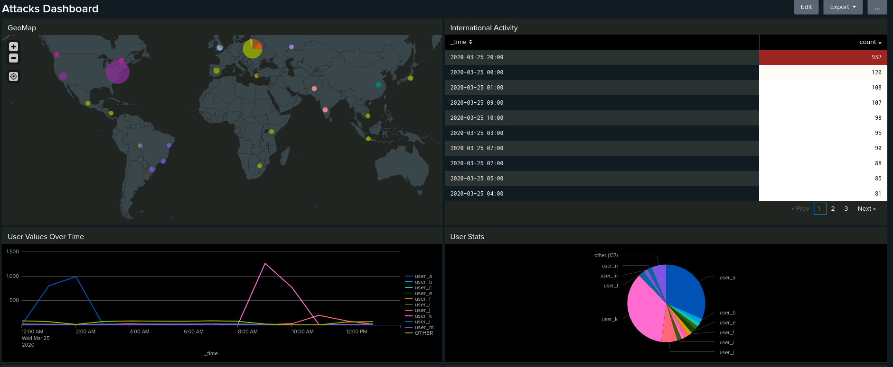
Screenshots - Attack Logs

Slide 48
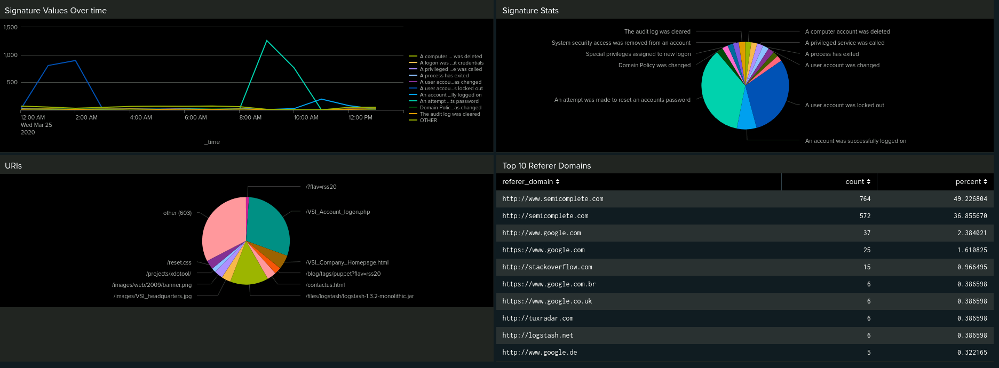
Screenshots - Attack Logs

Slide 49
Summary and Future Mitigations
‹#›
Notes:
Let's take a moment to appreciate the journey we've embarked upon today.
We've been navigating the intricate web of our Apache server's activity, dissecting logs, identifying patterns, and piecing together a comprehensive picture of our digital landscape.
It's been a fascinating exploration, revealing how our server interacts with the vast internet ecosystem.

Slide 50
Summary
Our overall findings from the attacks that took place?
The project has effectively utilized Splunk for analyzing and monitoring both Windows Server and Apache Web Server logs. Key findings include:
Windows Server Logs: Identified trends in failed and successful logins, user account deletions, and suspicious spikes in account lockouts and password resets. The alert thresholds were appropriate, capturing significant anomalies and peak activities.
Apache Web Server Logs: Uncovered suspicious HTTP POST activity, international traffic spikes, and unusual HTTP response codes. Alerts and thresholds were effectively set to capture anomalies, with key indicators pointing to potential scraping and brute-force attacks.
The analysis and monitoring setup have proven robust in detecting and responding to various security threats, with appropriate thresholds and alert configurations ensuring timely identification of suspicious activities.
Notes:
Alright y’all, let’s dive into what we discovered and what we can do moving forward.
Here are our Key Findings:
Involving the Windows Server Logs:
We identified trends in failed and successful logins, user account deletions, and spikes in account lockouts and password resets.
Our alert thresholds were on point, capturing significant anomalies and peak activities.
Now moving on to our Apache Web Server Logs:
We uncovered suspicious HTTP POST activity, international traffic spikes, and unusual HTTP response codes.
Our alerts and thresholds were effective in highlighting potential scraping and brute-force attacks.
Our setup proved to be robust in detecting and responding to various security threats, ensuring we can identify suspicious activities in a timely manner.

Slide 51
Summary (cont.)
To protect VSI from future attacks, we recommend these mitigations.
Strengthening Authentication: IMFA and enforce strong password policies.
Improving Log Management: Centralize and enhance log analysis for better anomaly detection.
Deploying Advanced Threat Detection: Use IDPS and EDR tools.
Enhancing Network Security: Implement network segmentation and update firewall rules.
Regularly Updates: Maintain a patch mgmt process and conduct vulnerability scans. Conducting Security Training: Provide ongoing training and simulate attacks to improve awareness.
Strengthening Incident Response: Develop and update an incident response plan and response team.
Performing Security Audits: Conduct regular penetration tests and security audits.
Securing Web Applications: Use a WAF and perform regular application security testing.
Enhancing Data Protection: Encrypt sensitive data and use Data Loss Prevention (DLP) tools.
Notes:
Future Mitigations
To protect VSI from future attacks, we recommend these measures:
Strengthening Authentication: Implement Multi-Factor Authentication (MFA) and enforce strong password policies. This will make it harder for unauthorized users to gain access.
Improving Log Management: Centralize and enhance log analysis to improve anomaly detection. This will help us spot issues quicker and more efficiently.
Deploying Advanced Threat Detection: Use Intrusion Detection and Prevention Systems (IDPS) and Endpoint Detection and Response (EDR) tools. These will help us detect and respond to threats in real-time.
Enhancing Network Security: Implement network segmentation and update firewall rules to better control traffic and limit potential attack surfaces.
Regular Updates: Maintain a patch management process and conduct regular vulnerability scans to ensure we’re protected against the latest threats.
Conducting Security Training: Provide ongoing training and simulate attacks to improve awareness among employees. This will help everyone stay vigilant and knowledgeable about potential threats.
Strengthening Incident Response: Develop and update an incident response plan and team to ensure we’re ready to act when incidents occur.
Performing Security Audits: Conduct regular penetration tests and security audits to identify and fix vulnerabilities.
Securing Web Applications: Use a Web Application Firewall (WAF) and perform regular application security testing to protect against web-based attacks.
Enhancing Data Protection: Encrypt sensitive data and use Data Loss Prevention (DLP) tools to prevent data breaches.
By implementing these measures, we can significantly enhance VSI’s security posture and better defend against future attacks. "And that wraps up our deep dive into the Apache attack analysis!
So, what have we learned today? We've seen how HTTP methods can tell us a lot about the traffic patterns, like how GET and POST requests are like the bread and butter of web traffic. We spotted some top referrers that might just be a little too eager in sending traffic our way—think of them as the overzealous party crashers of the internet.
On the response codes front, we've got a peek at how our server is handling requests. Peaks in the 200s show we're serving up content just fine, while spikes in 404s might suggest some digital potholes in our site that need fixing.
And let's not forget the international flair! We had a traffic surge from Kiev that practically screamed, "Hey, look at me!" High POST activity also caught our eye, making us wonder if someone’s trying to test the limits of our web forms—or worse, probing for vulnerabilities.
In summary, these insights aren’t just numbers; they’re like clues in a detective novel. Each peak and spike helps us piece together the story of our web traffic and spot potential trouble before it becomes a full-blown mystery.
Thanks for joining us on this journey through the digital landscape! Keep your dashboards sharp and your alerts smarter. Until next time, may your logs be clean and your traffic always predictable!

